Slide 1
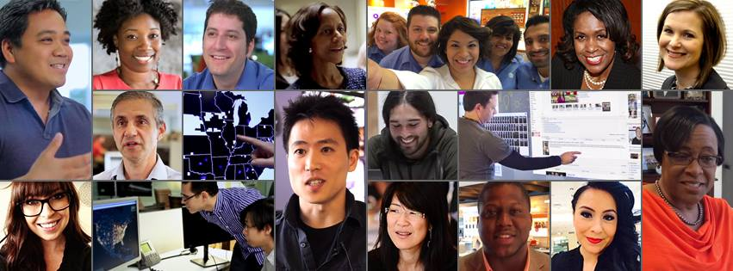
Leveraging Technology to showcase Diversity
Jennifer Terry-Tharp – Director, AT&T Talent Attraction
© 2015 AT&T Intellectual Property. All rights reserved. AT&T, the AT&T logo and all other AT&T marks contained herein are trademarks of AT&T Intellectual Property and/or AT&T affiliated companies. The information contained herein is not an offer, commitment, representation or warranty by AT&T and is subject to change.

Slide 2
Be Diverse. Don’t just say you’re diverse.
Authenticity is key
It’s “How” you communicate vs “Where” you communicate
Diverse audiences search for jobs just like everyone else
HispanicJobsinDallas.com
AsianWomenJobsinCalifornia.com
This doesn’t happen
Notes:
Use the cheesy stock image to leverage how fake many companies can be in promoting diversity
Really hammer down point on the way you communicate being key to diversity initiatives, vs just placing your message in places you think diverse audiences will go
Reiterate how many get into the trap of thinking that they need to target diverse audiences. Allude to how ridiculous some of it is when you really think about it. ‘Do women really use job search terms like “jobs for women” Where and how do you all look for jobs?

Slide 3
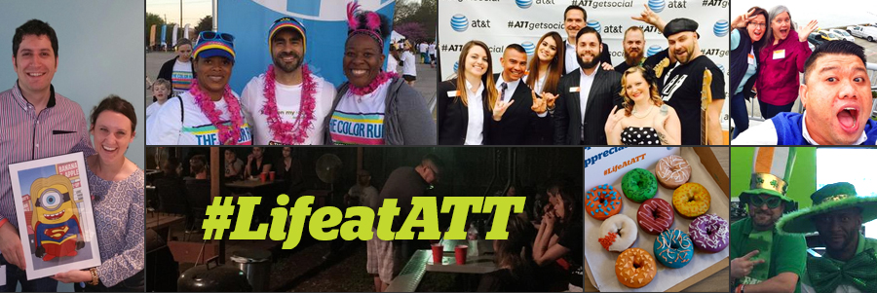
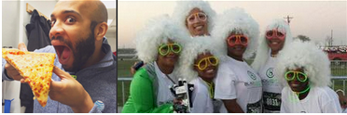
Crafting your diversity narrative. Keeping it real.
Identify your diverse targets & initiatives
Your employees are your most important asset when promoting a diverse culture. Leverage them.
Employees can help you tell stories
Employees can help you attract other like minded employees
Notes:
Talk about how you uncover the different diverse audiences you want to attract, military, women in tech, bilingual etc.
Talk about how the key to authenticity is simply showcasing the diversity that you have built
Allude to how Employee stories can be really inspiring and really help you craft a narrative (can dive into more details after social example)
One of the most effective ways to attract the top talent and maintain diversity is to utilize the employees you have to be culture magnets

Slide 4
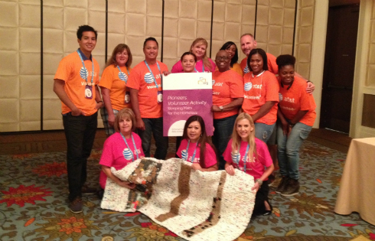
How to engage your workforce?
Develop Infrastructure for collecting Employee Generated Content & Stories
Leverage internal Employee Resource Groups as ambassadors
Identify key company events & conferences to spread messages and motivate employees
Notes:
Here‘s where you can talk about how we built processes for not only engaging employees, but also collecting great and interesting content from them. This is crucial in building content for your recruitment communications
Talk about the AT&T ERG’s and the role they play in promoting AT&T diversity

Slide 5
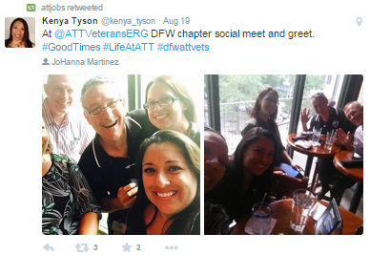
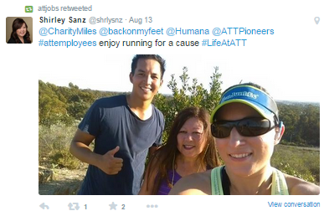
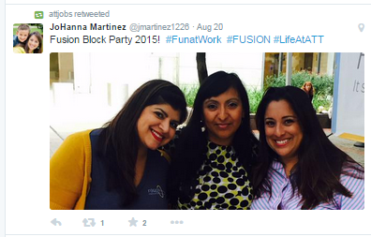
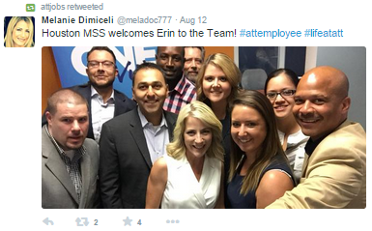
Leveraging Social Media to amplify diversity
Notes:
Describe our social strategy briefly and how employee generated content has become integral
Talk about how we have targeted ERG’s specifically to share and advocate these messages (these are ERG photos)

Slide 6
The impact of #LifeatATT
Quarter | 2014 Twitter Mentions | 2015 Twitter Mentions
Q1 | 62 | 1,295
Q2 | 92 | 1,802
Q3 | 474 | TBD
Q4 | 674 | TBD
Total | 1,302 | 3,097
Quarter | Estimated Impressions | Users
Q1 | 6,200,000 | 403
Q2 | 4,600,000 | 507
Total | 10,800,000 | 910
Potential reach of our message on Twitter
Notes:
Talk about how this really helps amplify these diverse messages
Talk about how finding this unique way of getting content, growing it has been such a great way for employees advocating the brand

Slide 7
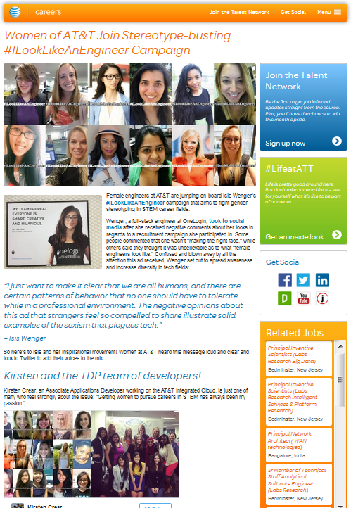
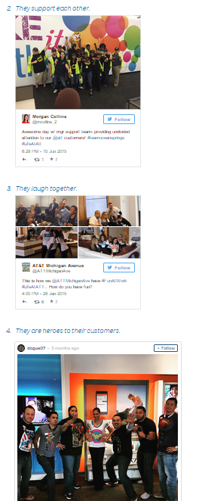
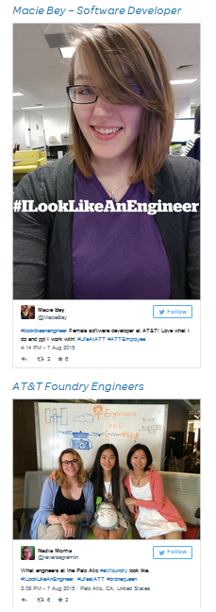
Building stories with “Social Content”
Notes:
This is where you can really talk about how we’re able to build compelling stories that really showcase at&t’s diversity in an authentic way

Slide 8
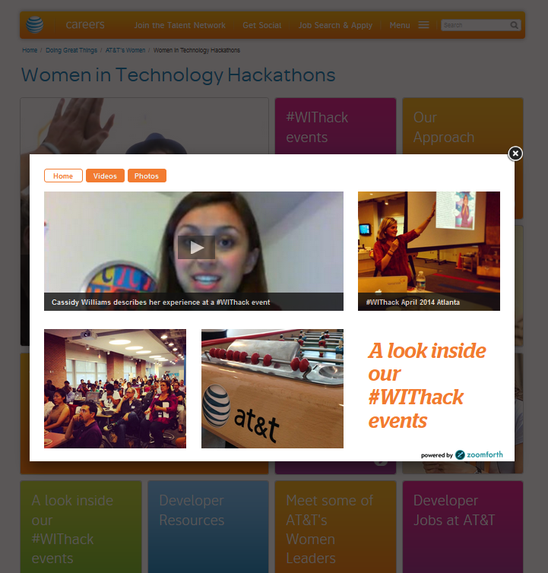
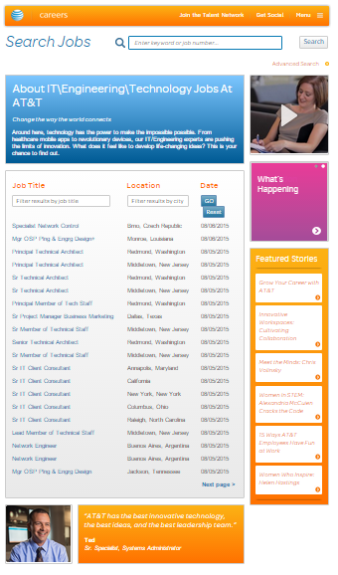
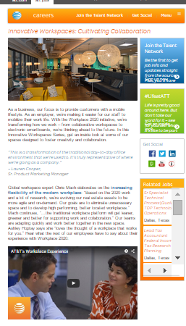
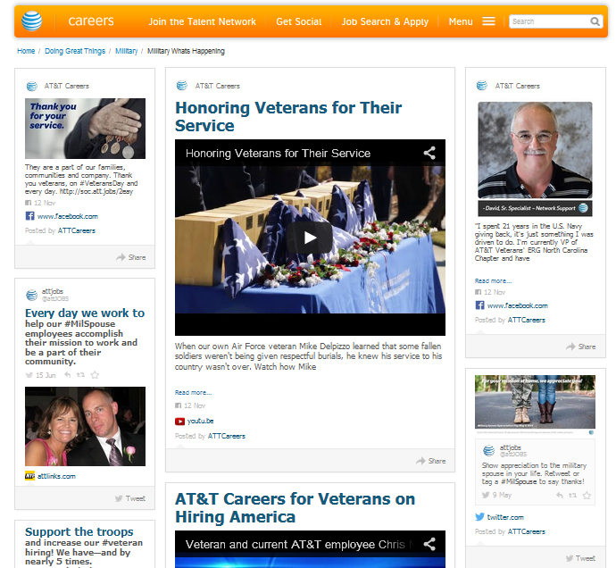
Right Place. Right time.
Tying content to jobs and jobs to content
Notes:
Talk about how you can leverage technology to make the content contextually relevant
-Zoomforth media widgets
-RebelMouse Feeds
-Articles on jobs and jobs on articles

Slide 9
Our of efforts help us to continue being a…

Slide 10
Let’s connect
@JTerryRecruit
/JennTerryTharp
@ATTJobs
/company/AT&T
/AT&TCareers

